Slide 1
A Practical Model for Computing Subsurface BRDF of Homogeneous Materials with A Thin Layer of Paint
Ke Chen Charly Collin Ajit Hakke-Patil Sumanta Pattanaik
Notes:
Hi, I am Charly Collin.
Our paper is about a practical model for computing subsurface BRDF of homogeneous materials with a thin layer of paint

Slide 2
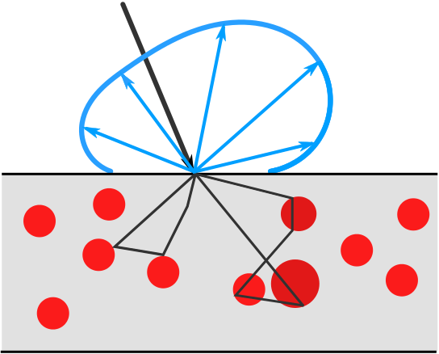
Overview
Notes:
The problem we are addressing in this paper is we are trying to model material have sphere particles embedded inside, like car paint.
And compute the subsurface BRDF due to subsurface scattering. We find a solution to radiative transfer equation to compute the BRDF and the computation is not required to propagate the light inside of the material, so it is very fast compare to ray tracing.

Slide 3
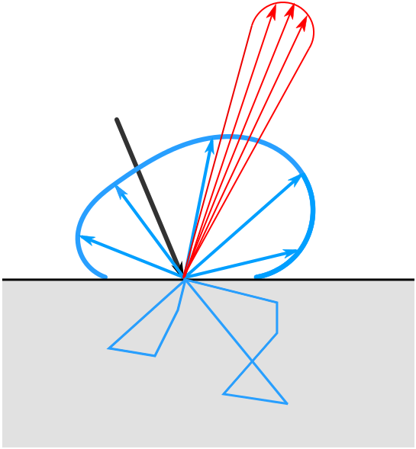
Introduction and motivation
BRDF = surface BRDF + subsurface BRDF
[Hanrahan and Krueger 1993]
Notes:
As we know that BRDF can be broadly separated into two parts: surface and subsurface BRDF as described by [Hanrahan and Krueger 1993]. The surface BRDF is the result of surface reflection (the red part in the figure) and subsurface BRDF due to subsurface scattering inside of the material (the blue lobe in the figure), which can be described by radiative transfer equation. For surface BRDF, it usually has a specular term and a diffuse term due to surface roughness. The subsurface BRDF along with the diffuse part of surface BRDF is often approximated as a Lambertian term. However, for most real world materials the subsurface BRDF is directionally dependent. So just using an scalar value is not enough to capture the optical feature of the material.

Slide 4
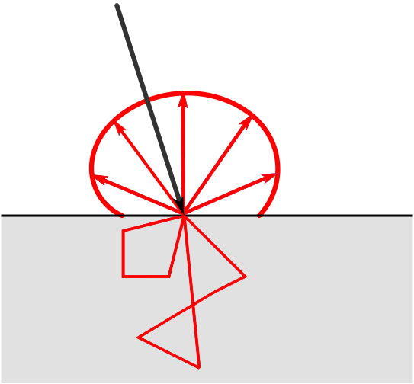
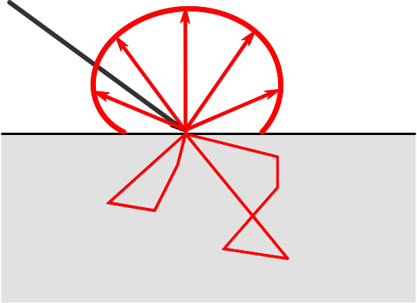
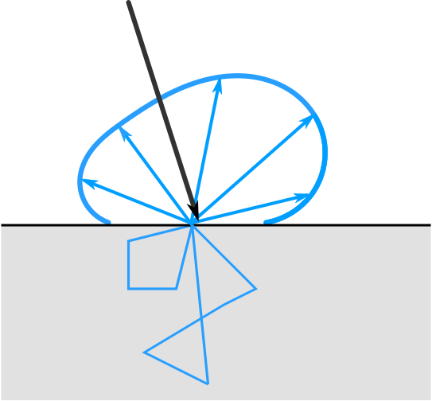
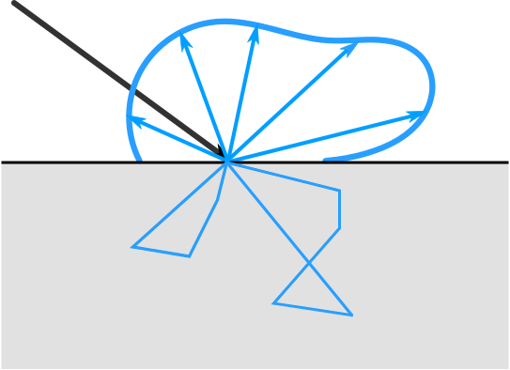
Subsurface BRDFs are directionally dependent
Shape does not change
Shape changed
Notes:
As you can see in this slide, the figures on the first row show the subsurface BRDF approximated by a Lambertian term. And the second row shows the physically correct subsurface BRDF, which has directionally dependent property. This means when incident light direction changes, the BRDF lobe should also change.
Our motivation of this paper is to find an efficient way to compute the subsurface BRDF for semi-infinite materials with a thin layer of paint and do not need to propagate the light inside of the material(like ray tracing), which is expensive and also, we want to demonstrate that, for real world materials, the subsurface BRDF is actually directionally dependent and can not be approximated using Lambertian term.

Slide 5
Previous Works and Limitations
Kubelka-Munk [Kubelka 1954]
Single scattering approximation [Blinn 1982], [Farrell et al. 1992]
Adding and doubling [de Haan 1987]
Discrete Ordinate Methods[Chandrasekhar 1960]
Notes:
Many methods have been proposed to compute subsurface BRDF. Kubelka-Munk method is an often used method for computing a scalar approximation of BRDF due to subsurface scattering. The method though efficient, is very approximate, because it simplifies the light field for each layer of the material by two streams: one downward and one upward value.
Blinn introduced single scattering approximation to add directional dependency, however, for physically correct rendering, multiple scattering should also contribute to this directional dependency.
Adding and doubling method and Discrete Ordinate Methods are standard ground truth radiative transfer solvers, which compute the light field for the bulk of the material, but they are very expensive.

Slide 6
Contributions
Subsurface BRDF for semi-infinite homogeneous materials
based on Ambartsumian’s integral equation [Chen et al. 2013]
Adding a thin layer of paint
based on invariant imbedding method [Hansen and Travis 1974]
Notes:
Our contributions consist of two parts. First of all, we use Ambartsumian’s integral equation to compute the subsurface BRDF for semi-infinite homogeneous materials.
And then we use the invariant imbedding method to modify the subsurface BRDF computed from previous step to get the subsurface BRDF for the semi-infinite material with a thin layer of paint on top of it.

Slide 7
Radiative transfer
Plane-parallel radiative transfer equation:
[Chandrasekhar 1960]
Notes:
For subsurface scattering analysis, radiative transfer equation is usually used as the starting point. The surfaces of many real-world materials may be considered as layered surfaces, which can be approximated as plane-parallel material. A plane-parallel material assumes that the radiance field inside of the material is constant throughout the horizontal plane for given optical depth tau. Under this assumption, the radiative transfer equation can be simplified to this plane-parallel radiative transfer equation.
Here L is the radiance due to subsurface scattering, (Eta, phi) stands for the cosine value of the propagating zenith angle and azimuth angle, respectively. S is the source function including in-scattering term.
By expanding all the spherical functions in this equation into Fourier series and than find the relationship between the reflectance function and the phase function. We can derive a integral equation that give us a way to compute the subsurface BRDF directly and do not need to propagate the light inside of the material.

Slide 8
Ambartsumian’s integral equation
Iteratively solving each
Notes:
This is the Ambartsumian’s integral equation, which is derived from the plane-parallel radiative transfer equation.
Here the R and p represent the reflectance function and the phase function, respectively. Alpha is the single scattering albedo. Eta stands for the angle. As you can see this equation relates BRDF with single scattering albedo and the phase function. We can solve this equation iteratively for each pair of incident and outgoing directions. By doing this, we are free from the expensive ray tracing method or discrete ordinate method.

Slide 9
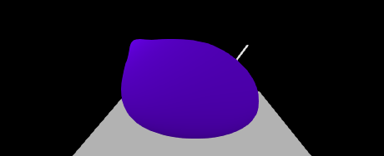
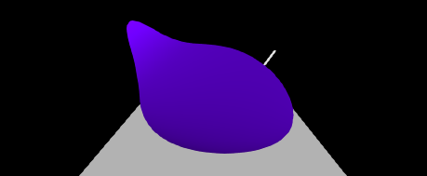
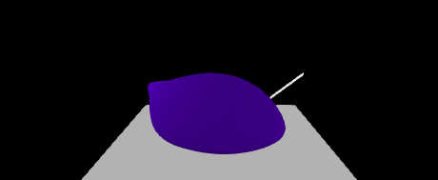
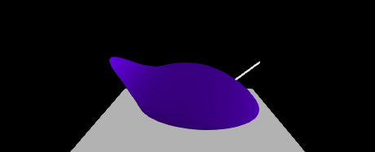
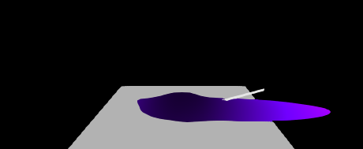
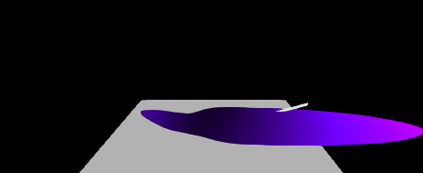
Subsurface BRDFs are directionally dependent
Titanium dioxide
Aluminium oxide
Notes:
Here we show the lobes of the subsurface BRDF computed from our solver for different incident light directions, the left column show the lobe of Titanium dioxide and right column shows the Aluminium oxide. You can clearly see that for different incident light angle, the lobes' shapes changed.

Slide 10
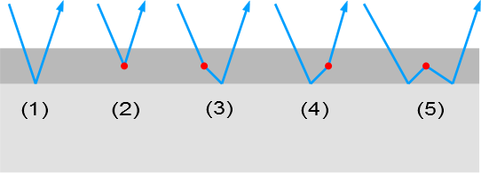
Invariant imbedding
(1)
(2)
(3)
(4)
(5)
Notes:
Based on previous results for semi-infinite material. We would like to put a thin layer of paint on top of it. The invariant imbedding method is used, which assumes that at most one scattering event can happen inside of this thin layer. So only five events could happen as illustrated in the figure.
(1) No scattering occurs, light reflects at the surface of the bottom layer.
(2) Light scatters and leaves the added layer without reaching the bottom layer.
(3) Light scatters and then reflects at the surface of the bottom layer.
(4) Light reflects at the surface of the bottom layer and then scatters out of the added layer.
(5) Light first reflects at the surface of the bottom layer, scatters and then reflects again by the bottom layer.
This will results in an equation describe the change of reflectance due to these five events.
And finally the subsurface BRDF will be reconstructed from these coefficients R_m_modified.

Slide 11
Results
Notes:
Rendering results of titanium dioxide and with different paintings

Slide 12
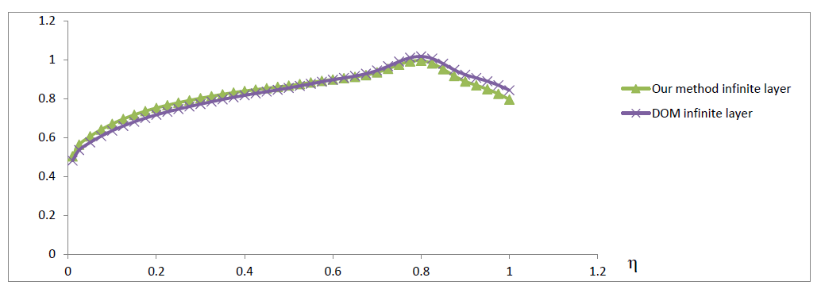
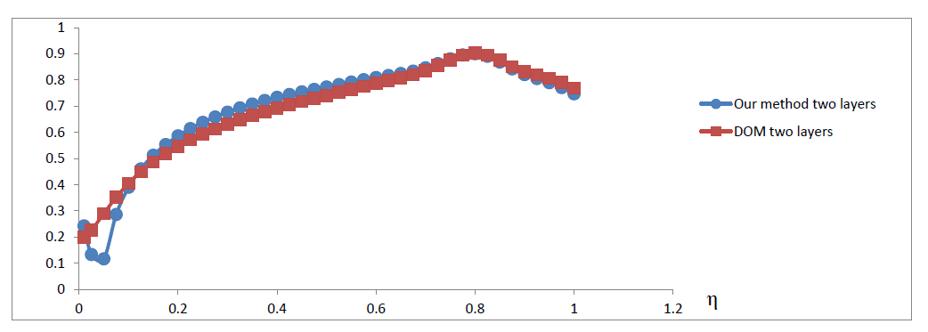
Conclusions
Subsurface BRDFs are directionally dependent
Using Ambartsumian’s integral equation and invariant imbedding to compute the subsurface BRDF is fast.
Accurate
Notes:
In conclusion, We also conclude that subsurface BRDFs are directionally dependent.
Also we provides fast subsurface BRDF algorithm using Ambartsumian’s integral equation and modified the BRDF due to a thin layer of paint using invariant imbedding method. The BRDF computation takes few seconds compare to ground true discrete ordinate method, which can take hours.
Our model is also accurate by comparing to discrete ordinates solver, which is shown in the figure,
1. semi-infinite layer
2. two layers

Slide 13
Future work
Polarization
Multiple layered materials
Notes:
In the future, we would like to extend our model for polarization and multiple layered materials

Slide 14
Thank You
Questions?
Notes:
Thank you!

