Slide 1
Visibility-driven progressive volume photon tracing
C. Collin (1) | M. Ribardière (2) | Gruson (2) | R. Cozot (2) | K. Bouatouch (2) | S. Pattanaik (1)
Hannover – June 12th, 2013
University of Central Florida, Orlando, USA
IRISA, Université de Rennes 1, Rennes, France
Notes:
Hello everybody
PRESENT myself
I am presenting to you our work about a new method to render scene containing participating media.
We have called this new method “Visibility-driven progressive volume photon tracing”

Slide 2
Content
1- Introduction
2- Related works
3- Our method
Beam view and hit points hierarchies
Visibility-driven (volume) photon tracing
4- Results
5- Conclusion
Notes:
This is the outline of my talk.
First, I’ll introduce the problem and give some theroritical backgrounds and then I’ll present to you some related works.
In the part 3, I’ll detail our contributions and our method.
Then, I’ll show you some results obtained with our method
Finally, I’ll conclude my presentation by opening new perspectives and future works.

Slide 3
Introduction
Rendering participating media with multiple scattering in reasonable time
solving the RTE (Radiative Transfer Equation)
$$L\left(x,ω\right)= \begin{matrix}\int_{0}^{S}{Tr\left(x↔x^{′}\right)σ_{s}\left(x^{′}\right)L_{i}\left(x^{′},ω\right)dx′ } \\ + Tr\left(x↔x_{s}\right)L(x_{s},ω)\end{matrix}$$
Light source
Image plane
$$x′$$
$$L(x_{s},ω)$$
$$L_{i}\left(x^{′},ω\right)=L_{single}+ …$$
$$L_{i}\left(x^{′},ω\right)=L_{single}+L_{multiple}$$
Hit point
$$x$$
$$ω$$
$$x_{s}$$
$$Tr(x↔x′)$$
$$\int_{0}^{S}{…dx′}$$
$$Tr(x↔x_{s})$$
Notes:
When we want to render scenes containing participating media as smoke, we have to find the solution of Radiative Transfer Equation (RTE)
Here is represented a simple scene with a light source, a surface, a camera and a smoke.
CLICK
The RTE gives the radiance arriving at a point x from a direction w.
This ray pass through the medium and intersects a surface
CLICK
This intersection point is called a hit point
The second term of the RTE is the attenuated radiance coming from the hitpoint. The attenuation is computed thanks the transmittance term Tr.
CLICK
What happen in the medium now along the ray w is given by the first integrand term…
CLICK
… which computes for each point x’ on w the incoming radiance from each direction around x’ (this is the term Li)
CLICK
Li is the sum of the single scattering radiance (from sources) and…
CLICK
Indirect Radiance coming from surfaces and scattering inside the medium itself

Slide 4
Existing approaches
How to solve the RTE?
Monte Carlo-Path tracing based approaches
Accurate and unbiased but…
… Noisy results or …
… Time consuming
Photon Mapping based approaches
Bias results but faster than MC-PT methods
In complex scenes, huge memory consumption
Progressive approaches
Remove the memory issue but…
… How to handle complex light paths?
Notes:
Of course, lot of rendering methods have been proposed to solve this RTE.
We can mention for example, the Monte Carlo Path tracing based method which are general, accurate and unbiased but the results are time consuming to obtain.
A solution to accelerate the computation is to use Photon Mappin based approach which are biased but can give faster results than MC-PT methods.
A problem with these methods is the memory needs to store particle. A way to solve this problem is to use a progressive approach, first proposed by Hachisuka and collegue in 2008 to render scenes without participating media.
Other techniques have been proposed but there are out of our topic.

Slide 5
Our method
Contributions
Progressive volume photon tracing based approach
Any kind of light-material interactions
Store view beams and visible points in 2 Kd-Trees
No photon storage (discarded once they have contributed to the image) : no memory limitations
The number of emitted photons is not limited
Visibility-driven photon shooting process
Use the visibility information to guide photon shooting steps (Metropolis strategy)
Better handling of complex light paths
Notes:
We choose to exploit the ability of the progressive particle mapping method and we extend there in volume rendering.
To do that, our new method store view beams and visible points in 2 Kd-trees structures.
I’ll give details in the next part of my talk.
As these structure stores the visibility part of the scene (that is to say the contributive part), we use it to guide the photon shooting proces thanks to a metropolis strategy.
The goal here is to handle complex light paths.

Slide 6
Related works
Progressive Photon Mapping
Photon Mapping
Number of photons
$$ω$$
Shoot photon
Store in photon map
Compute current image
Update final image
Number of iterations
Notes:
I explain now quickly how works a photon mapping technique
CLICK
A photon is a particle, shot from the light sources, and which can bounce on surface or inside the volume.
These particles represent a part of the power of the sources.
They are stored in a map called photon map, used during the rendering process.
In case of complex scenes, a huge number are needed to render noisyless images. Unfortunately, it is impossible to store these photons in memory.
CLICK
To remove the memory issue, progressive approaches shoot photons batch and made multiple iterations to decrease bias and remove noise.
Using these techniques allow to increase the number of photons used and results are better.

Slide 7
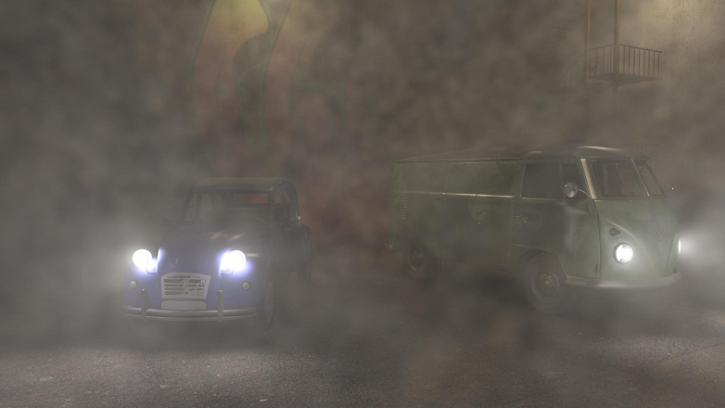
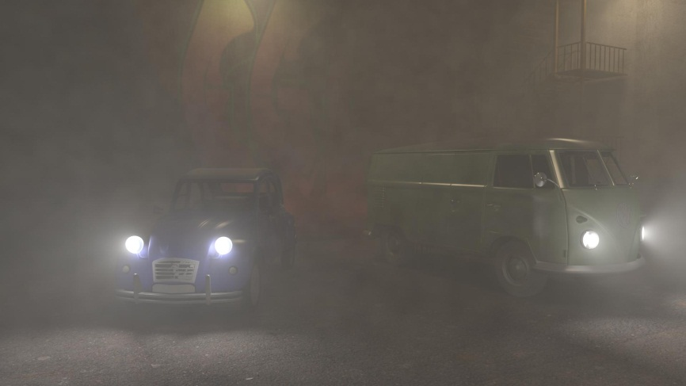
Related works
Progressive Photon Mapping
A probabilistic approach [APA] (Knauss et al. – 2011)
Notes:
In 2011, Knaus and collegue propose a probabistic approach to render participating media with a progressive photon mapping method.
They compute, thanks to a classical photon mapping technique, lot of noisy images and combined them to create the biaseless and noisyless final image.

Slide 8
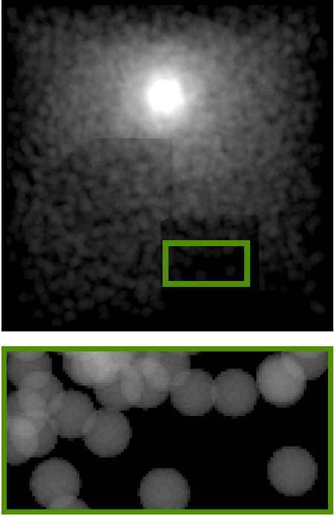
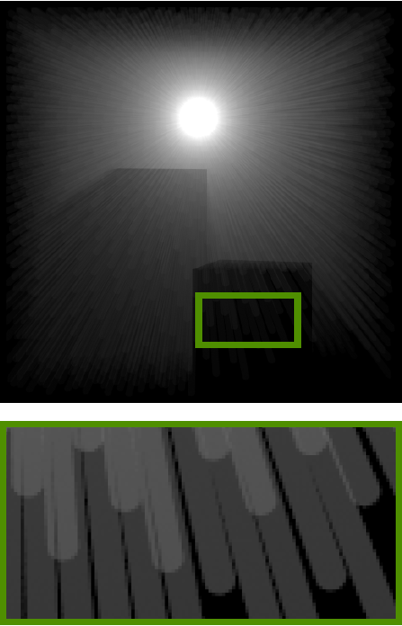
Related works
Progressive Photon Mapping
Beam photons [PPB] (Jarosz et al. - 2011)
Photon beam map
Notes:
Another optimisation was proposed by Jarosz & al. In 2011. Despite to use photons, they store the complete contribution of the light path through the medium and called these particles PHOTON BEAMS.
CLICK
This state of the art method gives good results due to the fact that beams better cover the volume.
Despite the fact that we also use beam, our method proceeds differently.
First, our beams are created from the camera and we call them VIEW BEAMS.
With our approach, we don’t build a photon map which allows us to send any number of photons per iterations. Moreover, it can be combined with photon beams.

Slide 9
Visibility-driven progressive photon tracing
The process
Shoot photon
Store in photon map
Compute current image
Update final image
Number of iterations
Notes:
So how it proceeds. Go back to the initial progressive photon mapping pipeline.
We want to remove the photon storage in a map.
CLICK

Slide 10
Visibility-driven progressive photon tracing
Overview of our method
Number of photons
Preprocessing
create hierarchies
Shoot photon
Compute photon contribution
Update final image
N iterations
Notes:
CLICK
We first create our hierarchy of all the visibility information from the camera.
CLICK
Then, when a photon is shot from the light source, its contribution is directly add to the image by performing a top-down hierarchy traversal.
Once its contribution is computed, the photon is discarded.
CLICK
The process continues to shoot a fixed number of photons.
CLICK
and when a set of photons is shot, the image is display and the process continue until N iterations or until the user stop it

Slide 11
Preprocessing
Specular surfaces
Notes:
Now, in detail, how performs the preprocessing step which consists in building the hierarchies?
We have a scene with a participating media, and different objetcts with different materials.

Slide 12
Preprocessing
1- Computing view points
2- Storing them in a Kd-tree
Notes:
A ray is shot from the camera and for each pixel.
The intersections with the surfaces, the hitpoints, are store in a kd-tree.

Slide 13
Preprocessing
3- Computing view beams
4- Storing them in a Kd-tree
(Havran et al. 2004)
Notes:
These rays can pass through the medium.
We assign for each ray passing through the medium a cylinder. A ray plus a cylinder is called a view beam.
These view beams are stored in a second kd-tree.

Slide 14
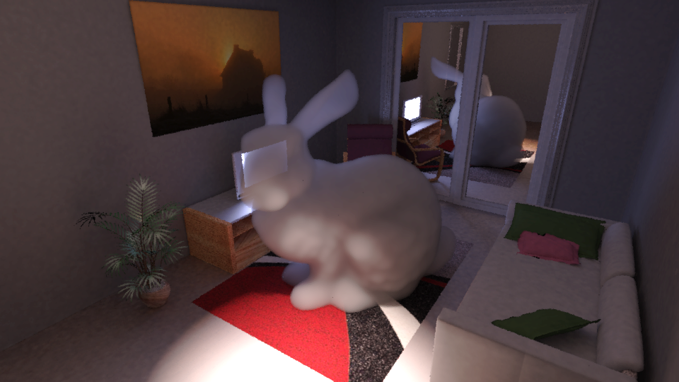
Rendering
Notes:
Then, during the rendering process, which consist in shooting photons from the light sources, the image is updated.
Let’s me take an example.
CLICK
A photon is emitted from the light source and intersects a surface.
CLICK
A top down traversal of the hit points kd-tree is performed to find the impacted hit points. Their radiance is updated with the power of the photon and…
CLICK
The image is updated and the photon is discarded.
CLICK
Now, the light path is reflected by the surface and interacts with the medium.
CLICK
A look up is performed in the beam view kd tree and the radiance of the impacted beam is updated.
CLICK
The process continue until the fixed number of photons per iteration is reached.

Slide 15
The aliasing issue problem
Anti-aliasing by reconstructing the hierarchies
Number of photons
Preprocessing
create hierarchies
Shoot photon
Compute photon contribution
Update final image
After N it.
N iterations
Rebuild the hierarchies
Notes:
As we only shot one ray per pixel, we obtain aliased images with this version of our method. This also implies that our method does not converge to an exact solution.
To remove this limitation, with a minimum of impact on the computation time, we rebuild the hierarchy after a certain number of iterations. So, new ray from camera are shot, and new hitpoints and view beams are stored in new kd-trees.

Slide 16
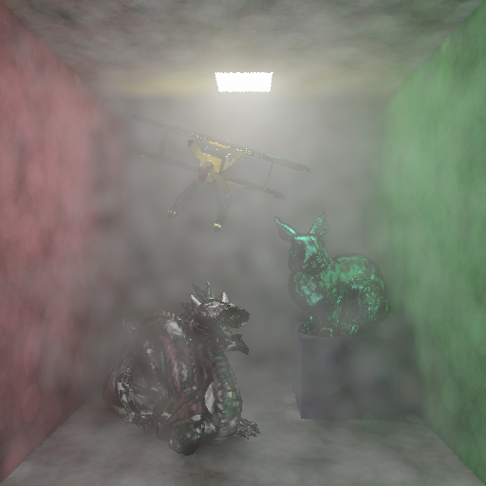
The aliasing issue problem
Anti-aliasing by reconstructing the hierarchies
N iterations
After 1st update
N iterations
N iterations
Image after one iteration
After 2nd update
After 100th update
Notes:
We can see the effect of this improvement on this test scene.
We are interested on the edge of the light source.
CLICK
After one iteration, we can see aliasing artefact.
CLICK
After a first hierarchies update, these artefacts start to decrease
CLICK
And finally, the image is free of aliasing.

Slide 17
Visibility-driven progressive photon tracing
Goals
More efficient sampling of light paths
Handle complex light paths
environment maps, lighting through double-glazed window, etc.
How?
Guide light paths using visibility information
These information are stored in hierarchies
Use a Metropolis strategy : replica exchange & Adaptive Monte Carlo Markov Chain
Visibility used as a target sampling function to guide the photon shooting process (Hachisuka et al. – 2011)
Notes:
The memory issue is now solved. But we can do more by better sampling light paths.
In the first version of our method, lot of photons which do not contribute to the image are created.
As we know directly if a light path contribute or not to the image, we can mutate this contributive paths by using a metropolis strategy.
Here, we used the approach proposed by Hachisuka and collegues.
Our method allows to extend this strategy to volume rendering.
More details are given in the paper.

Slide 18
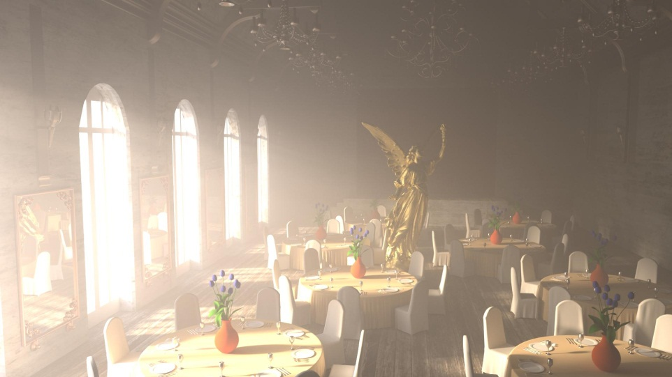
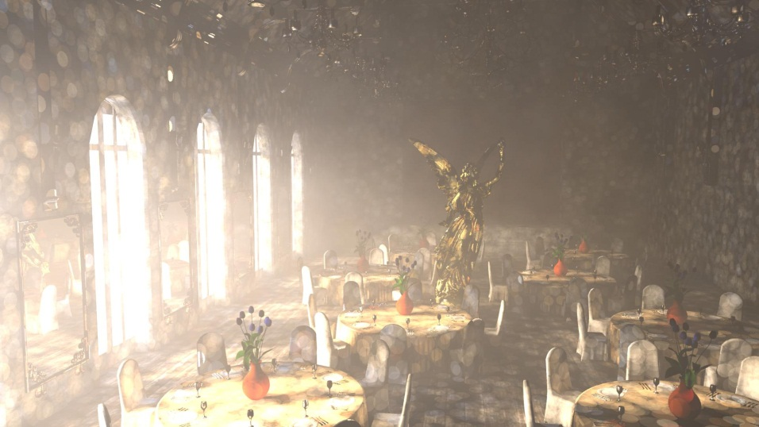
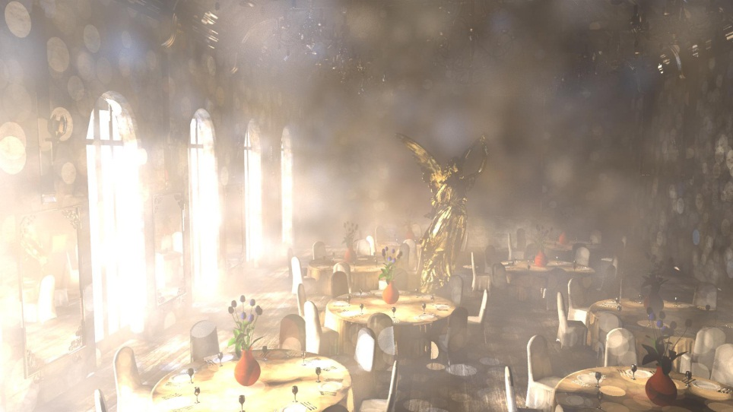
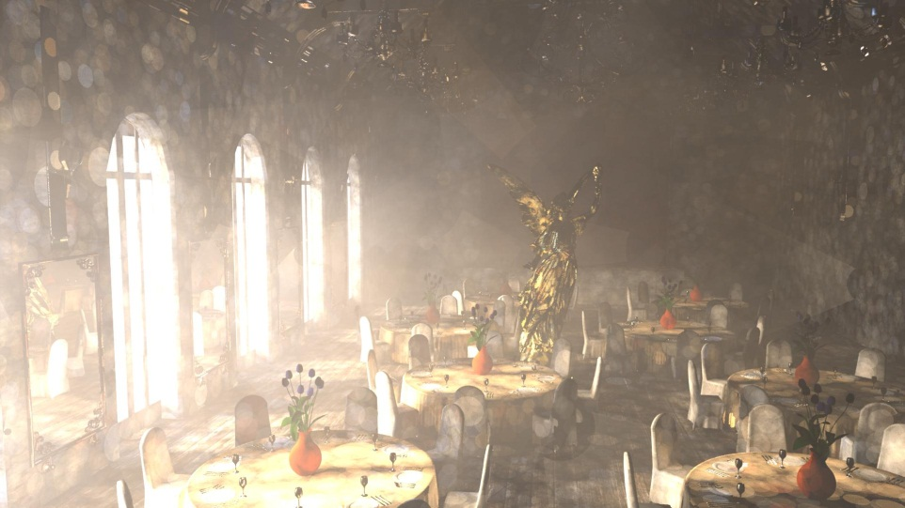
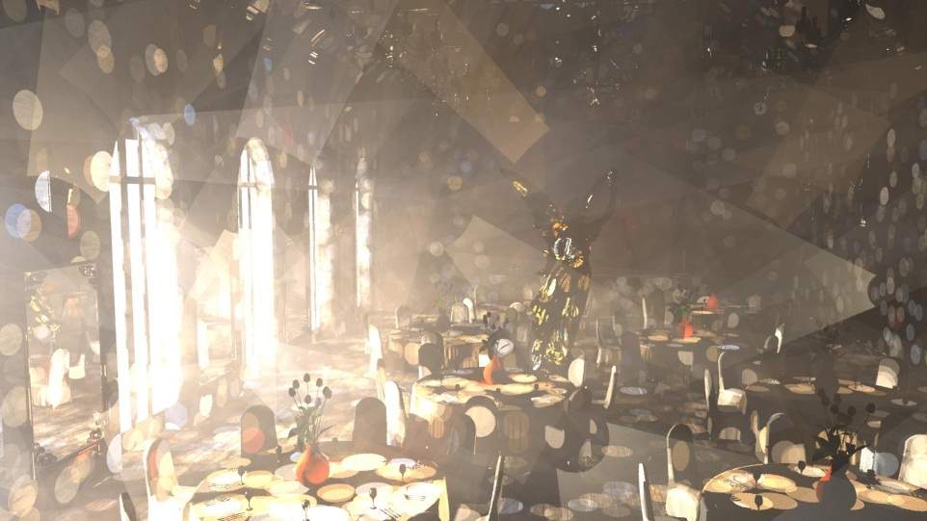
Results
30 min
10 h.
reference
APA
PPB
Notes:
Let me show you some results.
Référence = 30 jours sur machine équivalente

Slide 19
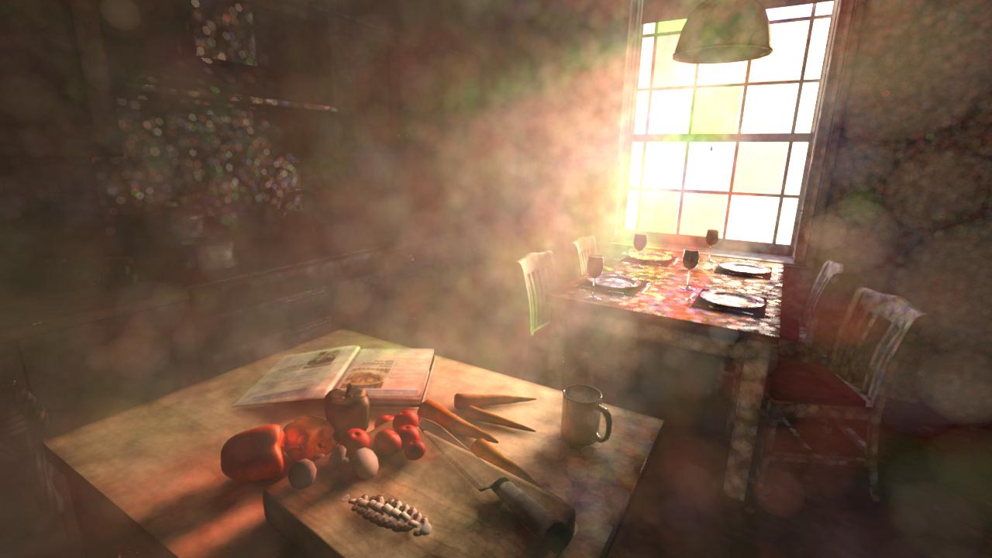
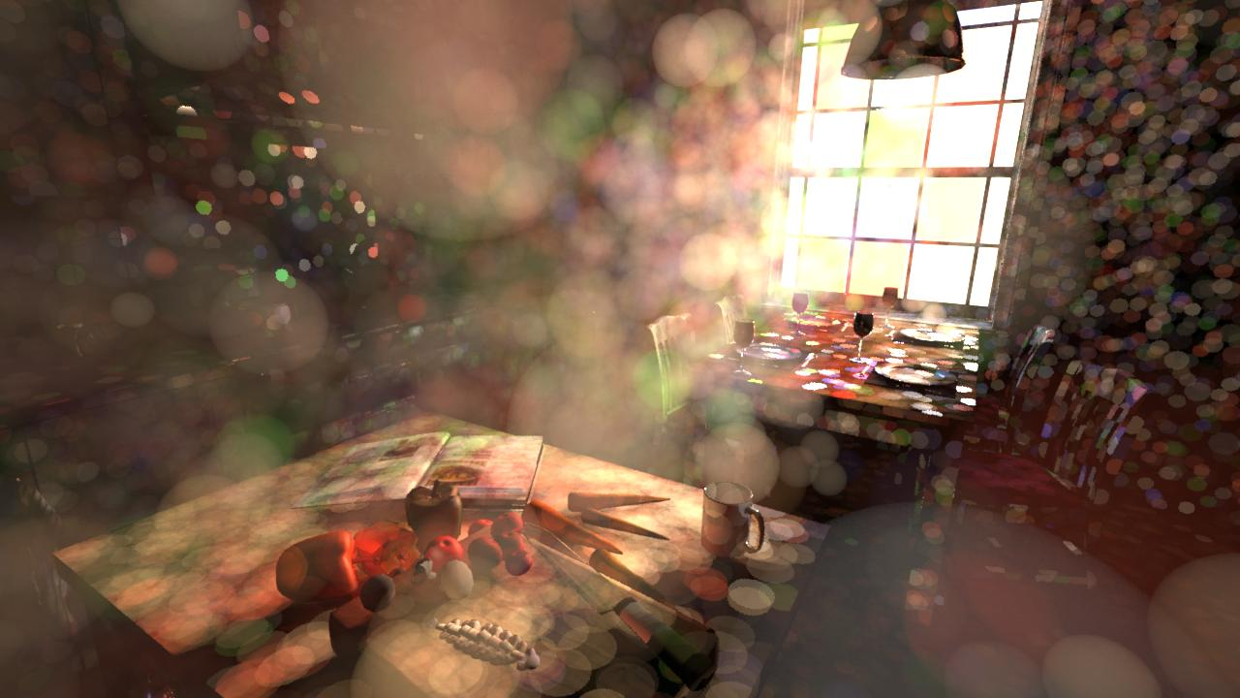
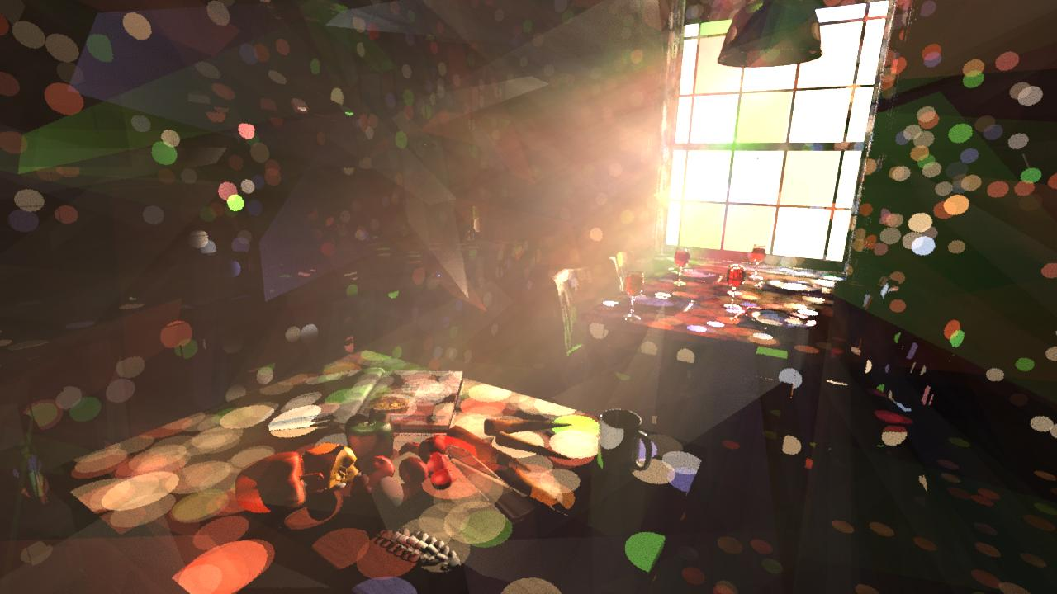
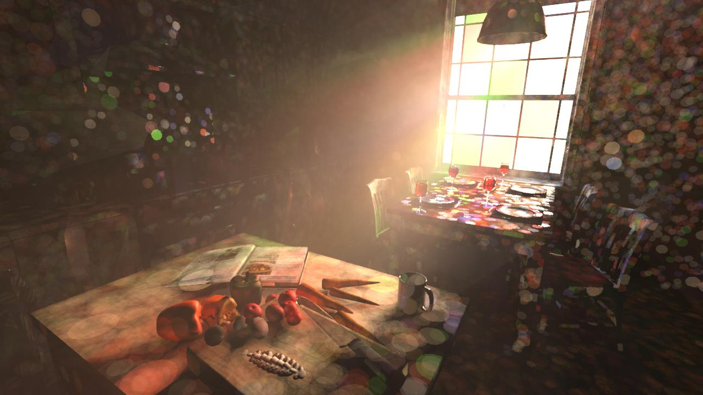
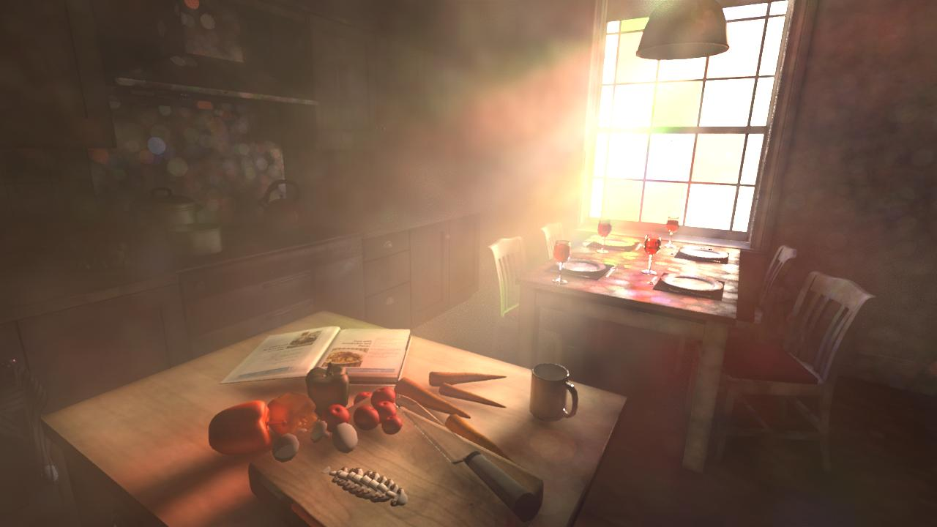
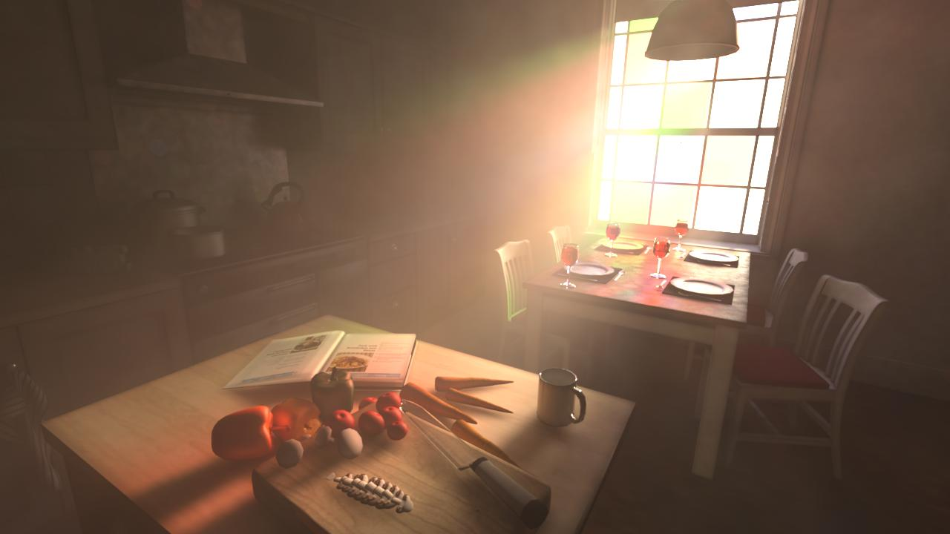
Results
30 min
10 h.
APA
PPB

Slide 20
Conclusion
New progressive volume photon based method
Easy memory management
No need to build new hierarchies for each iteration
Compatible with other existing particle based approach
Photon beams (Jarosz et al. – 2011)
Complex light paths handling (Metropolis strategy)
Use visibility information to guide photons shooting
Different kinds of light material interactions
Specular, glossy, refractions, multiple scattering, etc.
Futur works
starting bias : how to solve it?
highly depending on the initial parameters (initial radii, number of photons, etc.)
GPU implementation?
Notes:
To conclude my talk.

Slide 21
THANKS
?

